Slide 1

Human Resources
Board Presentation
May 19, 2021
SEE THE IMPACT

Slide 2


Human Resources
Who We Are
Natasha Truitt | Executive Director
Patricia Menard | Assistant Director
Ashley Barker | Generalist
Kris Duke, Laura Nilon, Roxanne Torres | Coordinators
Regina Johnson | Benefits Coordinator
Candy Sosa | Benefits Assistant
Monserrat Witine | Administrative Assistant
Aleyda Lopez | Recruitment Assistant

Slide 3


Human Resources
Services Provided
Employment and Recruiting
Compensation Administration
Benefits Administration
Training and Development
Unemployment and Workers’ Compensation Administration
Employee Relations and Services
Personnel Records Management

Slide 4
Human Resources
OUR EMPLOYEES

Slide 5

Human Resources
Workforce Size
Full Time:
782
77%
Part Time:
233
23%
Total: 1015

Slide 6


Human Resources
Workforce
By Division
INSTRUCTIONAL PROGRAMS AND SERVICES | 825
Head Start | 258
Adult Education | 206
HCDE Schools | 159
School-Based Therapy Services | 163
Center for After-school, Summer and Enrichment | 30
Teaching and Learning Center | 9
DISTRICT OPERATIONAL SUPPORT SERVICES | 25
Center for Safe and Secure Schools | 5
Educator Certification and Advancement | 6
Grants Development | 6
Research and Evaluation | 8
ENTERPRISE PROGRAMS | 31
Choice Partners | 18
Records Management | 13
SYSTEM-WIDE SUPPORT SERVICES | 134
Includes support divisions such as Business, Communications, Facilities, IT, HR, etc. | 134

Slide 7

Human Resources
Staff Qualifications
 | Number | Percentage
Doctorate | 21 | 2%
Masters | 249 | 25%
Bachelors | 376 | 37%
Associate | 81 | 8%
High School Diploma/GED | 271 | 28%
SBEC Certification | 226 | 22%
Licensed Professionals | 174 | 17%

Slide 8

Human Resources
ETHNICITY
 | African American 416 | 41%
 | Hispanic 284 | 28%
 | Anglo 254 | 25%
 | Asian 41 | 4%
 | Other 20 | 2%
SEE THE IMPACT

Slide 9


Human Resources
GENDER
81%
FEMALE
19%
MALE
822
193

Slide 10

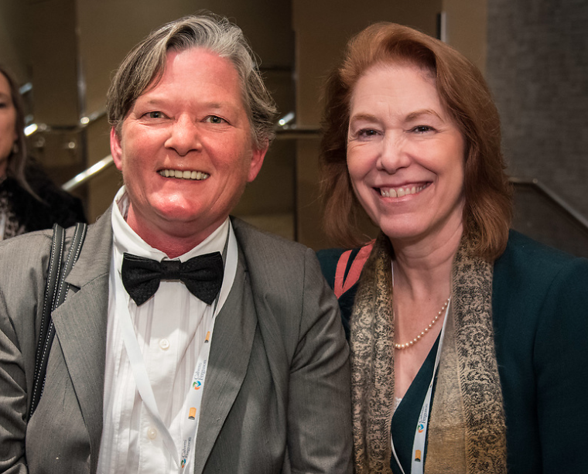
Human Resources
Length of Service
36-40 Years
1 | 1%
31-35 Years
3 | 1%
26-30 Years
11 | 1%
21-25 Years
47 | 5%
16-20 Years
95 | 9%
11-15 Years
116 | 11%
6-10 Years
146 | 14%
0-5 Years
596 | 58%

Slide 11
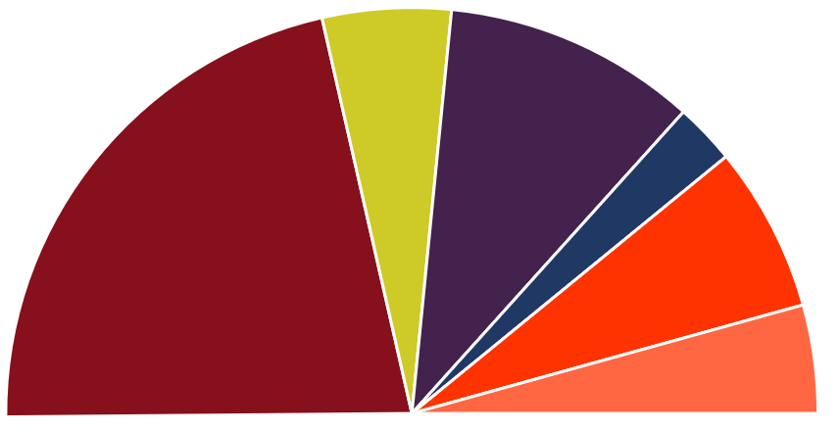
Human Resources
Recruitment Efforts
Applications Received: | 3,344 |  | Job Fairs Attended: | 6
Positions Posted: | 62 | Number of new hires: | Full-time: | 83
External Website/Job Boards: | 101 |  | Part-time: | 41

Slide 12
Human Resources
LEAVE & BENEFITS

Slide 13
Human Resources
Benefits Enrollment
SEE THE IMPACT

Slide 14
Human Resources
Leave and Worker’s Comp Administration
Family and Medical Leave | Temporary Disability Leave | Military Leave
126 | 3 | 0
Leave of Absence | Workers’ Comp Claims | Assault Leave
0 | 34 | 30

Slide 15
Human Resources
COMPENSATION

Slide 16

Human Resources
Compensation Highlights
#1 Teacher Pay - $62,000
$13.50/hr minimum wage
Competitive salary schedules
100% premium paid employee
medical benefit
SEE THE IMPACT

Slide 17
Human Resources
KEY HIGHLIGHTS

Slide 18


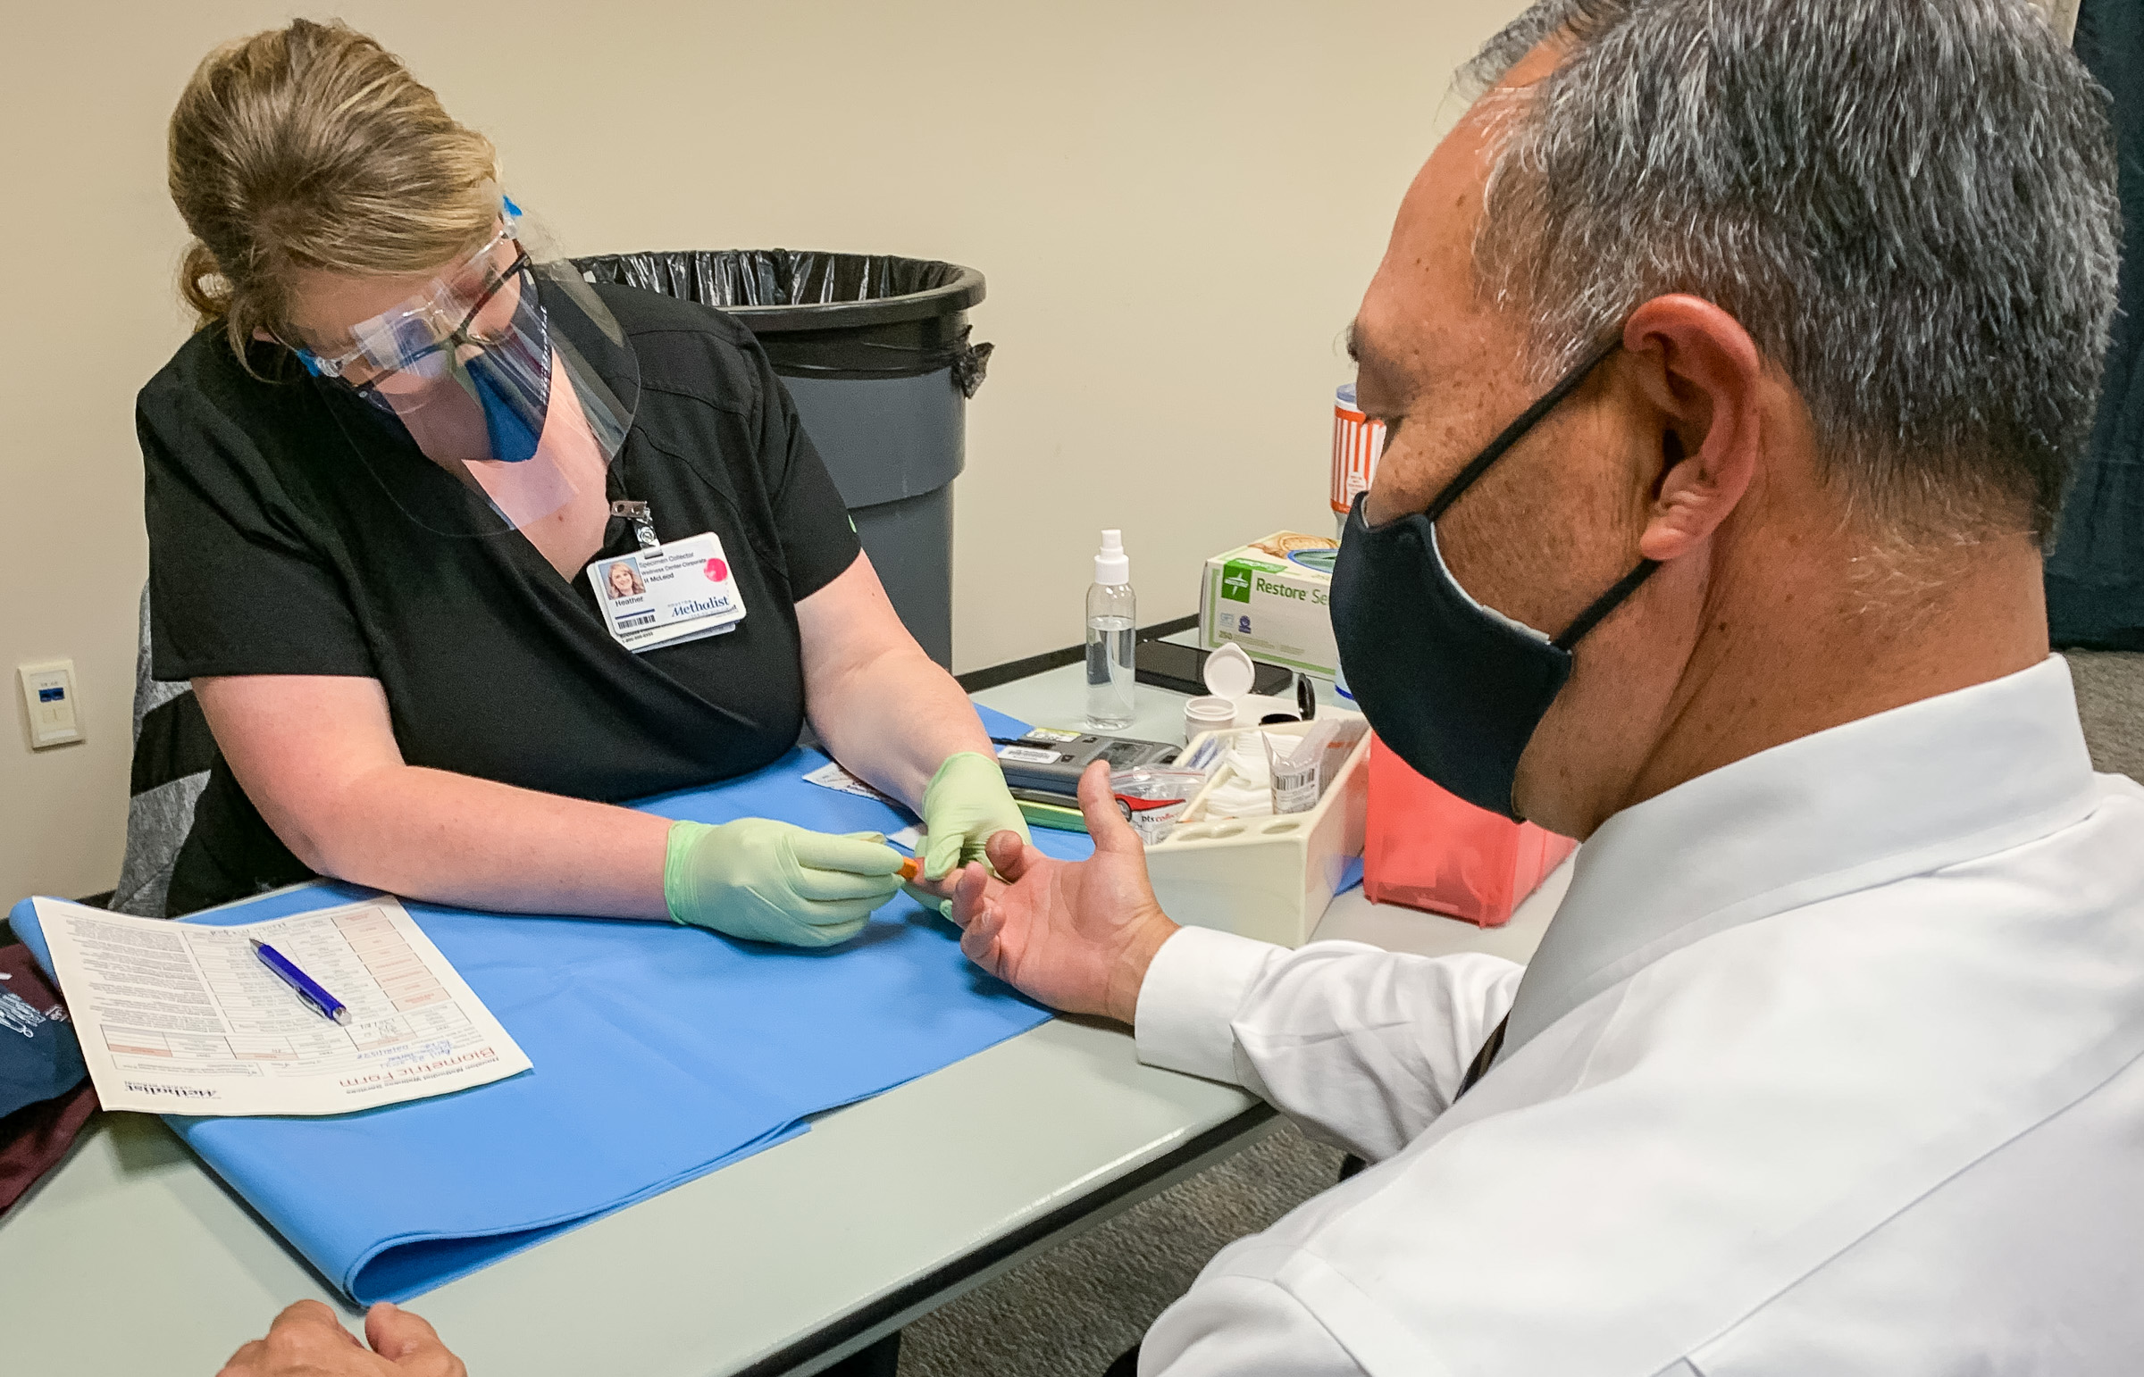
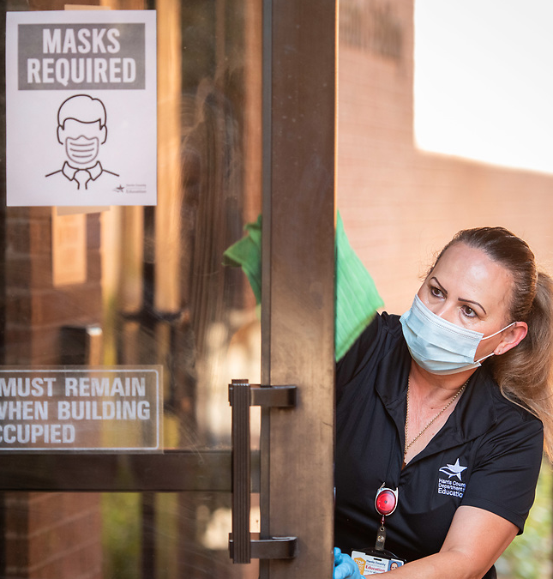
Human Resources
Key Highlights
2020 Houston Top Workplace
130 businesses recognized (3,000 nominated)
HCDE = #13 in large businesses (up from #24 in 2019)
85% employee response rate
COVID-19 Response
CDC Guidelines, TEA Guidelines, HCDE Exposure Control Plan
Employee and student exposure, diagnosis, contact tracing
Liaison with Harris County Public Health
Employee Required Training
Online modules (self paced)
New Employee Orientation
Returning Employee Information
Document Management System
Implemented new system to take HR processes paperless
  From application to contracts to separation
  Onboarding for new employees
Employee Wellness Program
Partnership with Houston Methodist
Biometric Screenings
Monthly webinar for employees on topic of interest
Nutritional support and guidance

Slide 19

Human Resources
Trends
Learning management system for training
Investment in mental health
Automated HR processes
Employee Wellness programs

Slide 20
Human Resources
SEE THE IMPACT
Questions?

